Slide 1
Flooding & Distance Vector

Slide 2
Flooding
Sends all packets to all network nodes
Router logic:
For every packet received from a link, send it out over all other links
Does this guarantee a packet will traverse the shortest path?
How do we prevent routing loops?

Slide 3
Distance Vector Routing
It is a distributed algorithm:
Shortest path computation is split across nodes
Computation is often (but not always) based on the “Distributed Bellman-Ford” algorithm
Logic:
Each router knows “distance” to its neighbours.
Routers periodically share their lowest known distance to all network destinations (Distance Vector).
They share this information only with their neighbouring routers.
Routers use received vectors to update their own.

Slide 4
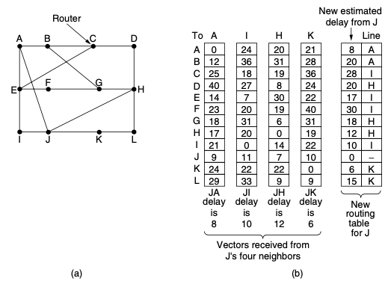
Distance Vector Routing
(a) A network. (b) Input from A, I, H, K, and the new routing table for J.

Slide 5
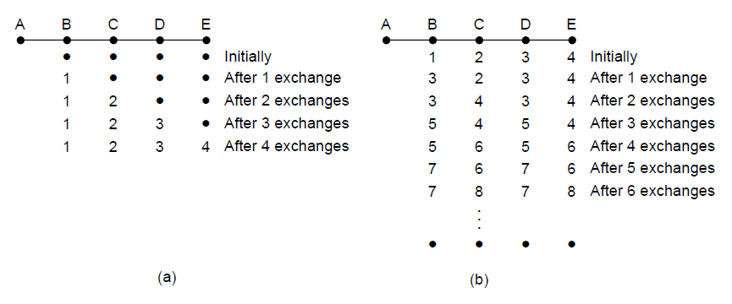
The Count-to-Infinity Problem
Failures can cause DV to “Count to Infinity” while trying to find a path to unreachable node

